Slide 1

Bridging the Performance Gap for Copy-based Garbage Collectors atop Non-Volatile Memory
Yanfei Yang, Mingyu Wu, Haibo Chen, Binyu Zang
Shanghai Jiao Tong University

Slide 2
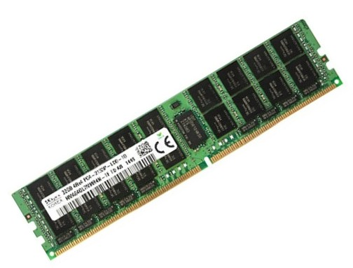
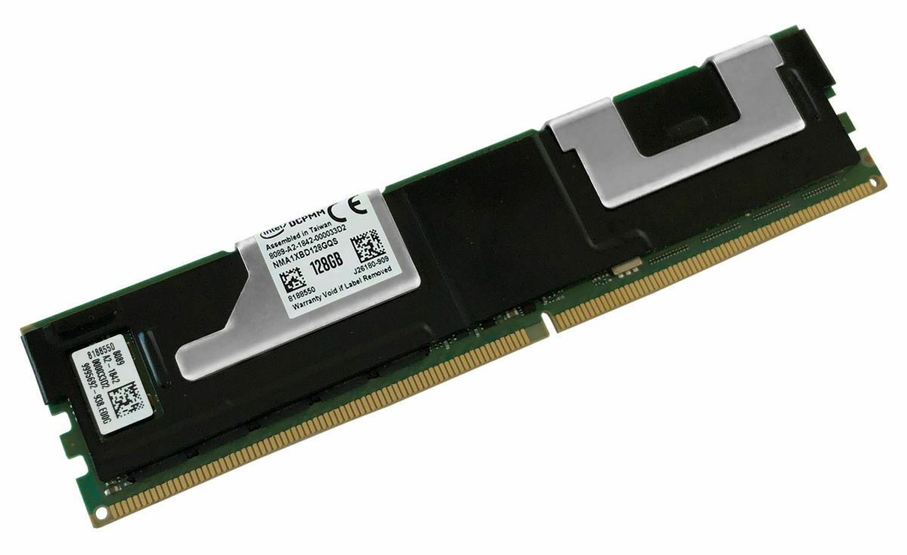
NVM: More than Non-Volatile
Commodity NVM is also known for its capacity, power efficiency, and lower price
Using NVM as a large alternative memory device for DRAM
NVM
DRAM
non-volatility
byte-addressability
large-capacity memory
large capacity
DRAM
NVM
lower price
power efficiency

Slide 3




Using NVM in Managed Languages
Applications in managed languages already have large appetites for memory resources
a
OpenJDK has allowed heap allocation atop NVM (JEP-316)
Most memory accesses will touch NVM instead of DRAM
Large heap
NVM
Other data
DRAM

Slide 4
NVM is Not Perfect
Prior work has uncovered performance problems of NVM compared with normal DRAM^{[1]}
Larger access latency
Smaller bandwidth
Asymmetric bandwidth -> sensitive to workload
Bandwidth
Write ratio
 | Rand. read | Seq. read | Max read bandwidth | Max write bandwidth
NVM | ~300ns | ~170ns | 39GB/s | 14GB/s
DRAM | ~100ns | ~80ns | ~120GB/s | ~80GB/s
[1] Izraelevitz et al. Basic Performance Measurements of the Intel Optane DC Persistent Memory Module.

Slide 5
Performance Analysis for Java@NVM
Evaluation setup
Intel Xeon Gold 6238R CPU (28 physical cores, SMT enabled)
6 Intel Optane DC PMs (128GB * 6)
Benchmark: six applications from Renaissance^{[1]} and Spark
Breaking into APP phase and GC phase
GC time is severely affected
Slowdown: 2.02-8.25x (access latency: 2-3x)
[1] Prokopec et al. Renaissance: Benchmarking suite for parallel applications on the jvm (PLDI19).

Slide 6
Background: Copy-based GC
Many modern collectors in managed languages are copy-based
E.g., G1/PS in OpenJDK, mark-compact in CLR
Copy-based GC collects the heap by moving live objects together
Large bandwidth consumption due to object copying
Live object
free space
GC

Slide 7
The Culprit for GC Slowdown: Bandwidth
The bandwidth reaches NVM limit during GC (page-rank)
For DRAM: Bandwidth increases during GC
For NVM: Bandwidth drops during GC for the same workload
DRAM
NVM

Slide 8
Bandwidth and GC Scalability
NVM bandwidth also affects GC scalability (still page-rank)
DRAM: GC bandwidth continuously increases -> scale to 64 cores
NVM: GC bandwidth reaches its limit -> scale to 8 cores
DRAM
NVM

Slide 9
Bandwidth For Other Applications
Other applications show different memory behaviors (als)
Bandwidth is not saturated during application execution
The application time barely changes when moving to NVM (10%)
DRAM
NVM

Slide 10
Diving Into Details: The Copy-based GC Algorithm
Taking G1 (default in OpenJDK) as an example
Region-based: partitioning the heap into regions for management
G1 Heap
region

Slide 11
Diving Into Details: The Copy-based GC Algorithm
Taking G1 (default in OpenJDK) as an example
Region-based: partitioning the heap into regions for management
Generational: only a few regions are collected in most cases
G1 Heap
young
region

Slide 12
Diving Into Details: The Copy-based GC Algorithm
Taking G1 (default in OpenJDK) as an example
Region-based: partitioning the heap into regions for management
Generational: only a few regions are collected in most cases
Multi-threaded: each thread has its own stack on references
stack
Thread 1
……
Thread 2
Thread 3

Slide 13
Diving Into Details: The Copy-based GC Algorithm
The G1 algorithm on reference processing
Step 1: fetch a reference from its working stack (read)
Step 2: Copy to another region (read & write)
Step 3: Update the forwarding pointer in the old copy (write)
The G1 algorithm on reference processing
Step 4: Update the reference with its new address (write)
Step 5: Push unprocessed references to the stack (read)
Repeat…
G1 Heap (NVM)
Thread

Slide 14
Diving Into Details: The Copy-based GC Algorithm
The G1 algorithm on reference processing
Step 1: Fetch a reference from its working stack (read)
Step 2: Copy to another region (read & write)
Step 3: Update the forwarding pointer in the old copy (write)
Step 4: Update the reference with its new address (write)
Step 5: Push unprocessed references to the stack (read)
Problem: Mixing writes with reads!
……
Bandwidth
R
RW
W
W
R
R
RW
W
W
R
R
RW
W
W
R
R
RW
W
W
R
R
……
Less Bandwidth
Write ratio
More writes

Slide 15
Design 1: Separating Data Update
Introducing a region write cache for NVM updates
One-to-one region mapping for NVM regions
Objects will be copied to DRAM instead of NVM
Region Cache (DRAM)
G1 Heap (NVM)

Slide 16
Design 1: Separating Data Update
Introducing a region write cache for NVM updates
One-to-one region mapping for NVM regions
Objects will be copied to DRAM instead of NVM
Before GC ends, flushing objects to NVM (NT instructions)
Region Cache (DRAM)
G1 Heap (NVM)
Flush
Non-temporal instr.

Slide 17
Design 1: Separating Data Update
Introducing a region write cache for NVM updates
Splitting GC into two phases: read-mostly and write-only
The remaining problem: header update
Vanilla
R
RW
W
W
R
R
RW
W
W
R
……
+Design 1
R
RW_{D}
W
W_{D}
R
R
RW_{D}
W
W_{D}
R
……
W
Read-mostly
Write-only

Slide 18
Design 2: Reducing Header Update
Introducing a header map to store forwarding pointers
Organized as a hashmap (old address -> new address)
The header update now becomes an insert operation to the map
header update
H
1. hashing
2. linear probing
3.2. header update (NVM)
header map
old
addr
new
addr
3.1. map update

Slide 19
Design 2: Reducing Header Update
Introducing a header map to store forwarding pointers
Now all steps in the read-mostly phase avoid NVM writes
Although some NVM writes occur when linear probing fails
+Design 1
R
RW_{D}
W
W_{D}
R
R
RW_{D}
W
W_{D}
R
……
W
+Design 2
R
RW_{D}
W_{D}
W_{D}
R
R
RW_{D}
W_{D}
W_{D}
R
……
W

Slide 20
Controlling DRAM Consumption
Both two designs require DRAM resources
Write cache: proportional to the live object size
Header map: proportional to the number of live objects
Solution 1: introducing knobs to limit DRAM usage
The maximum cached regions and map size can be set
Solution 2: eagerly reclaiming DRAM resources
Early flushing objects to NVM when they are ready

Slide 21
More in Our Paper
Premature flushing with non-temporal instructions
Software prefetching
Integrated to other collectors

Slide 22
Evaluation

Slide 23
Evaluation Setup
Hardware configuration (mentioned before)
28 cores (SMT enabled), 6*128G NVM (mounted with DAX)
Software configuration
OpenJDK 12.0.1 (support JEP-316)
Applications: Renaissance (16GB), Cassandra (16GB), Spark (256GB)
Baseline: vanilla G1

Slide 24
GC Improvement
23/26 applications are improved
1.69X GC time reduction
write cache only: 1.17X
Performance gap between DRAM: 2.28X
Close to the latency gap

Slide 25
Bandwidth Improvement
Increased by 55.0% on average (up to 2.58X)
Detailed bandwidth: separating reads and writes helps!
Read-mostly
Write-only
Optimized
Vanilla

Slide 26
Scalability
Using chi-square as an example
Vanilla (baseline): only scale to 4 cores
+writecache (design 1): reducing writes and scale to 20 cores
+all (both design): further scale to 56 cores
Not effective with fewer cores
NVM Bandwidth is not saturated
Introducing more DRAM accesses

Slide 27

Conclusion
Commodity NVM can be used as alternative memory
Welcomed by memory-intensive applications in managed languages
Java has provided NVM support
GC performance suffers due to NVM’s limited bandwidth
Our optimizations sufficiently utilize NVM bandwidth
Write cache: absorbing data update to DRAM cache
Header map: storing header update to a hash map
Thanks!

